Slide 1

YouTube Videos Classification
Submitted by:
Bhavneet Kaur

Slide 2
INTRODUCTION
Problem statement
YouTube has a library of millions if not billions of videos and keeping a track of the types of videos for effective retrieval and use can be quite difficult. YouTube videos can be classified using numerous techniques like classifying videos based on their content, comments on videos, and many more metrics. But these methods can be complex and time consuming .
The main idea behind the project
I have tried applying a machine learning model in order to classify the videos.
The machine learning model will classify the youtube videos into six different categories using data like title and description.
The six categories are “Travel Blogs”, “Food” , “Science and Technology”, “Manufacturing”, “History”, “Art and music”.

Slide 3
Libraries ,Tools and Software Used
Libraries used: pandas, numpy ,scikit-learn ,NLTK.
Tools used: beautiful Soup , requests and Youtube API
Software requirements: Anaconda Navigator, Jupyter notebook
Classifier used: Multinomial naive bayes classifier

Slide 4
What is Naive Bayes Classifier?
Naive Bayes is a classification technique based on Bayes Theorem. It is one of the simplest supervised learning algorithms. Naive Bayes classifier is the fast, accurate and reliable algorithm. Naive Bayes classifiers have high accuracy and speed on large datasets.
Naive Bayes classifier assumes that the effect of a particular feature in a class is independent of other features. For example, a loan applicant is desirable or not depending on his/her income, previous loan and transaction history, age, and location. Even if these features are interdependent, these features are still considered independently. This assumption simplifies computation, and that's why it is considered as naive. This assumption is called class conditional independence.

Slide 5
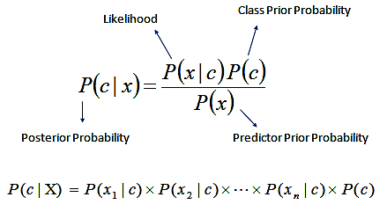
Multinomial Naive Bayes Classifier
Multinomial Naive Bayes is widely used for text classification as it is easy to understand and accurate.
It calculates the frequency of each word i.e word count.

Slide 6

Design Flow
Step1) Gathering data
Step 2) Data preprocessing
Step 3) Researching the model that will be best for the type of data
Step 4) Training the model
Step 5) Testing the Model

Slide 7
Data Extraction
Choosing the right data is one of the most important part of any Machine Learning project.
I have gathered youtube videos data like title and description using tools like Youtube API, Beautiful Soup and Requests.
Youtube API ,is used to get the youtube video links.
Using the information like “video_id” we use the request package to get the HTML of that specific youtube video.
Beautiful Soup is then used to mine the page and extract the video’s title and description.
The collected data has been stored in a “csv” file.

Slide 8
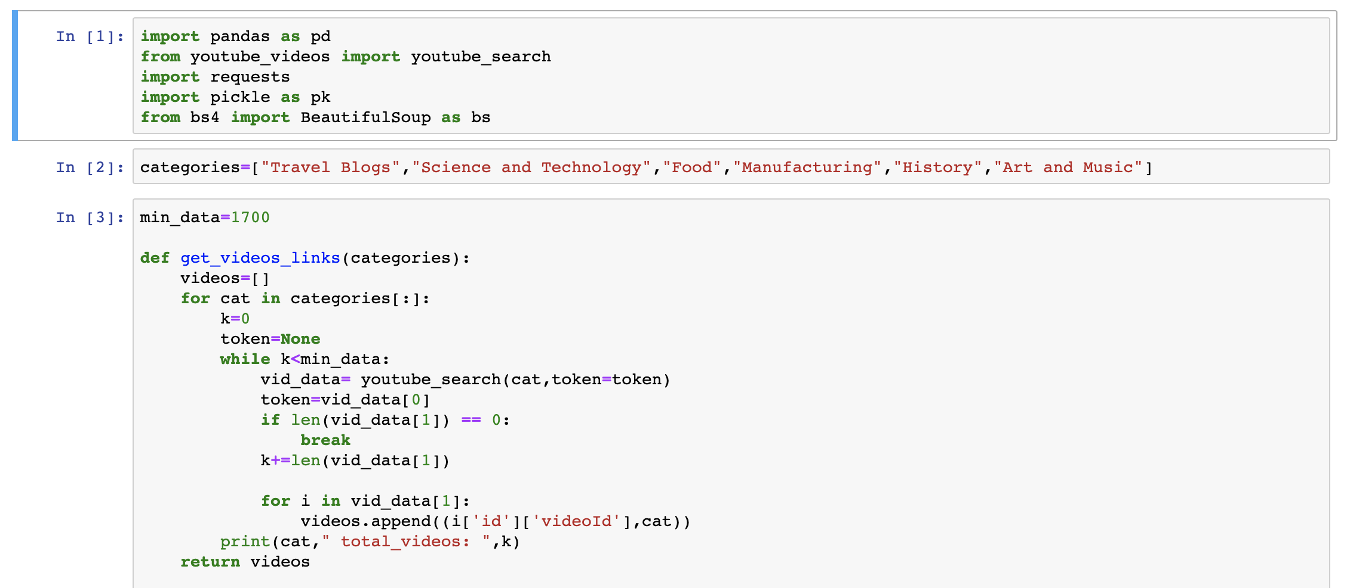
Code- Data Extraction

Slide 9
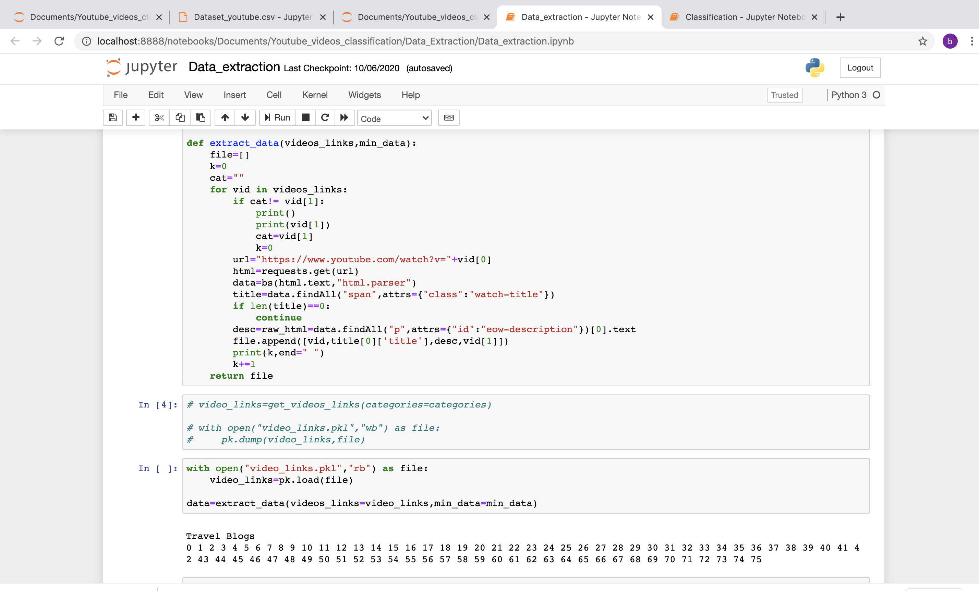
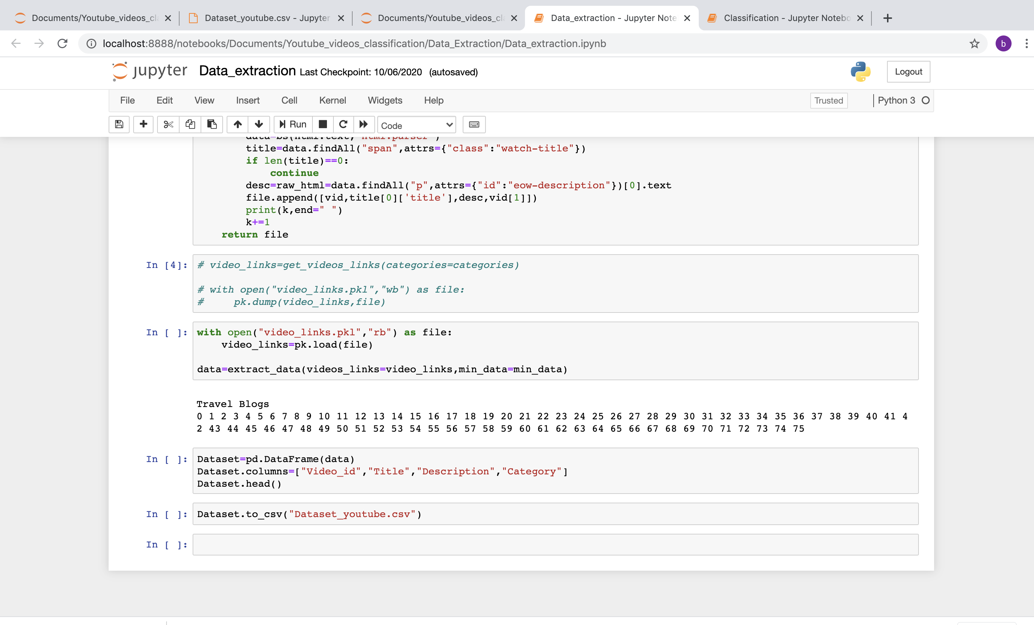

Slide 10
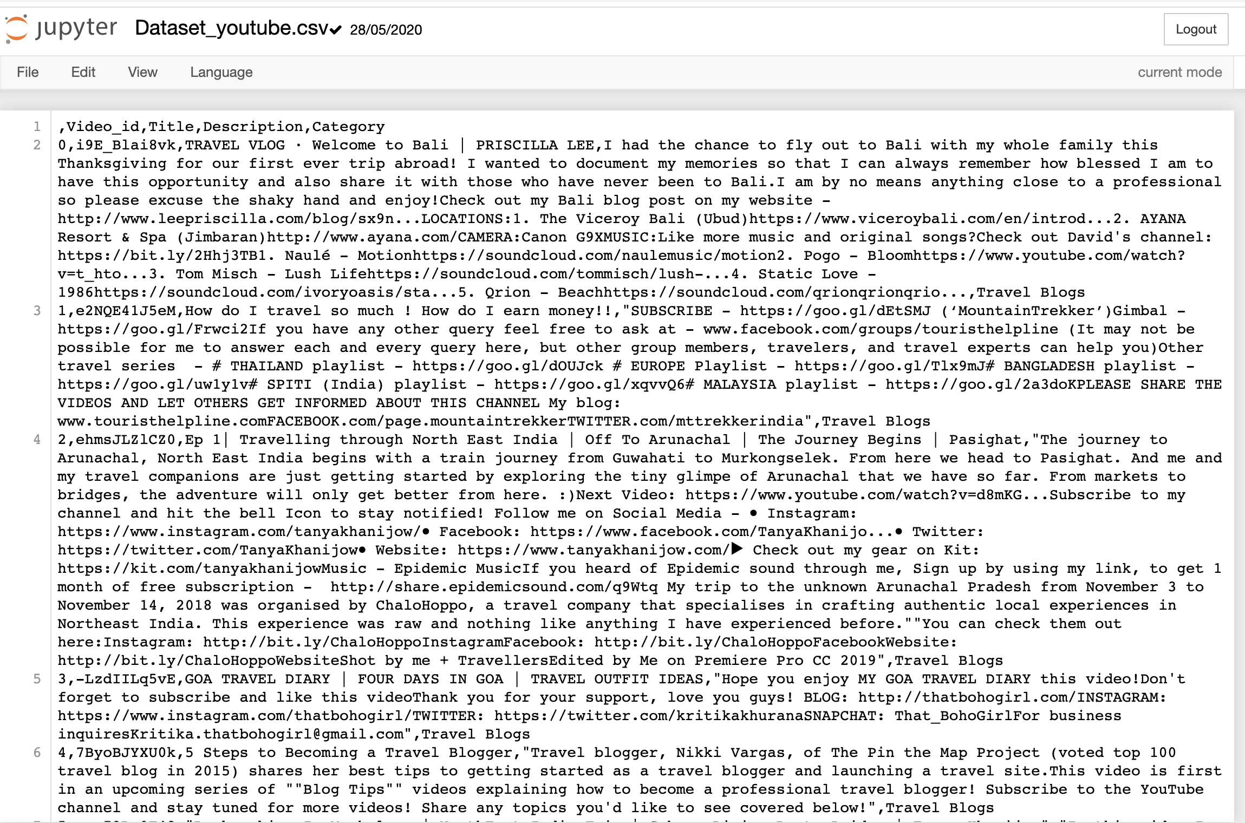
Dataset

Slide 11
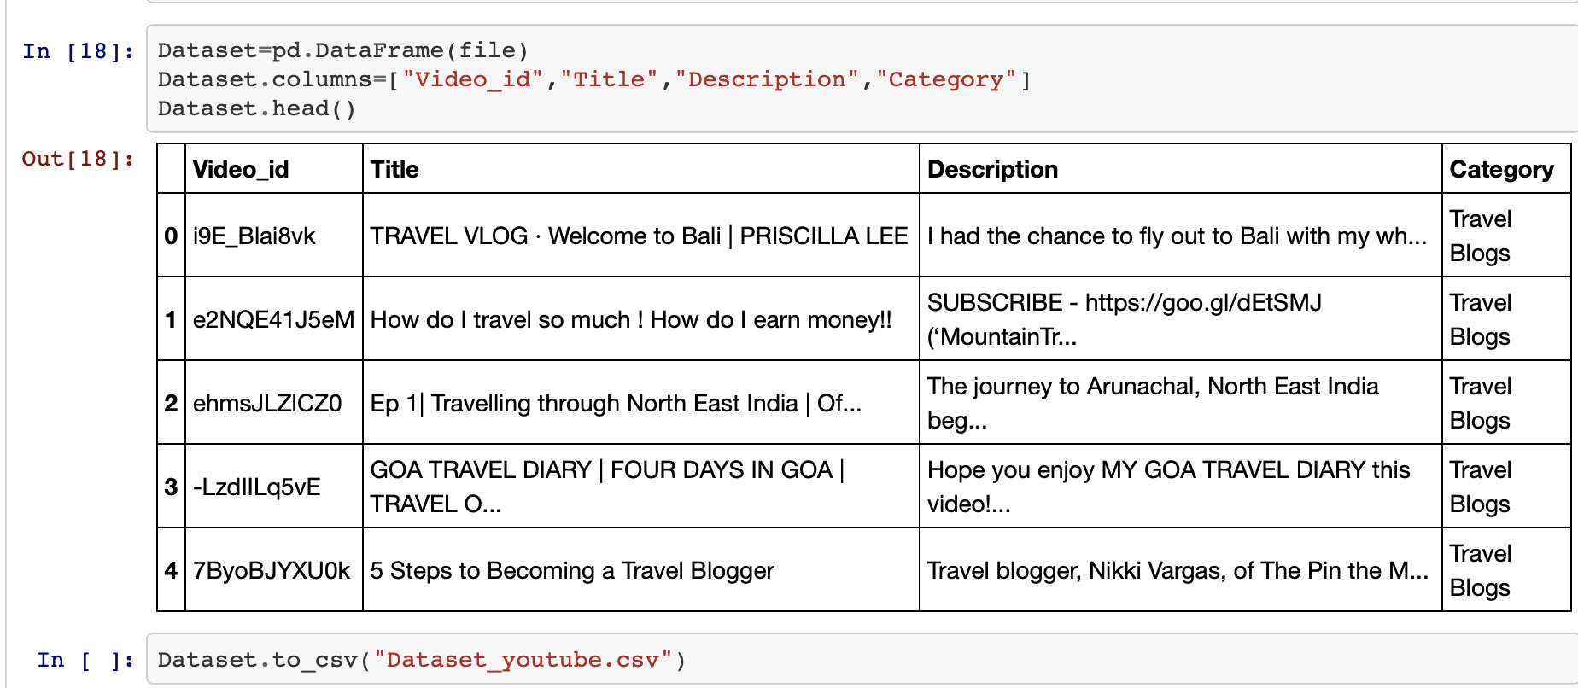
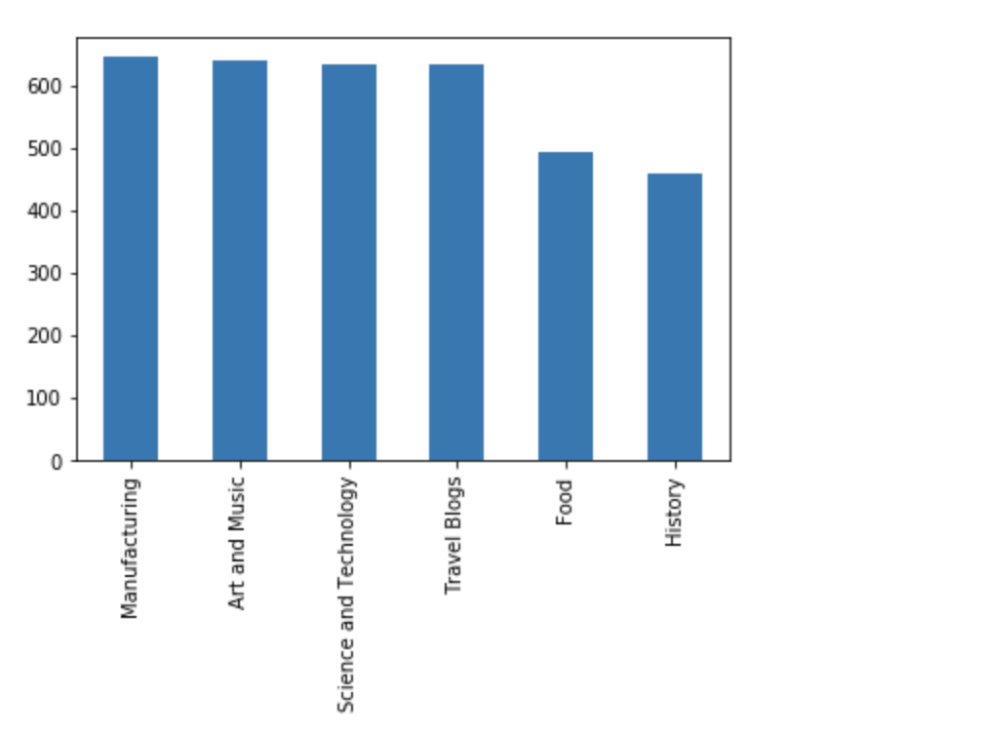
Dataset
The dataset has four different columns as “video_id”, “title”, “description” and “category”.
There are in total around 5303 videos of six different categories.

Slide 12
Data Preprocessing
Data pre-processing is a process of cleaning the raw data i.e. the data is collected in the real world and is converted to a clean data set. In other words, whenever the data is gathered from different sources it is collected in a raw format and this data isn’t feasible for the analysis.Here are some preprocessing steps that are used to convert the raw data:
Converting to lowercase- ‘Travel’ and ‘travel’ should be treated as the same.
Removing numerical values and punctuations($,! etc.)
Tokenizing into words-This refers to splitting a text string into a list of ‘tokens’, where each token is a word. For eg, “I love travelling” will be converted into [‘I’, ‘love’ , ‘travelling’]
Removing non-alphabetical words and ‘Stop words’: : ‘Stop words’ refer to words like and, the, is, etc, which are of no use during predictive analysis.
Lemmatization is a pretty rad technique that converts similar words to their base meaning.For eg. the words ‘flying’ and ‘flew’ will both be converted into their simplest meaning ‘fly’.

Slide 13
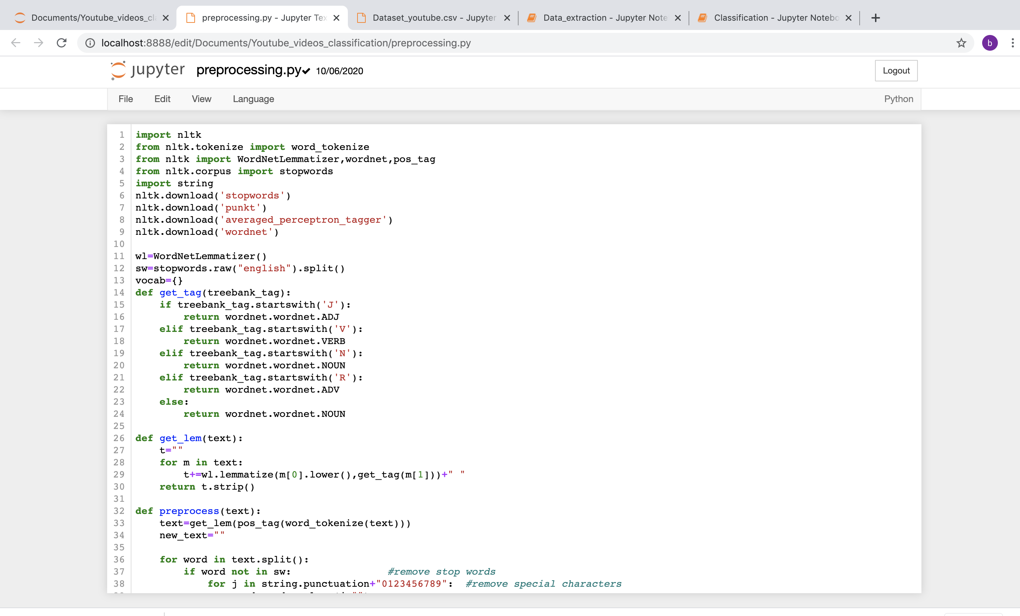
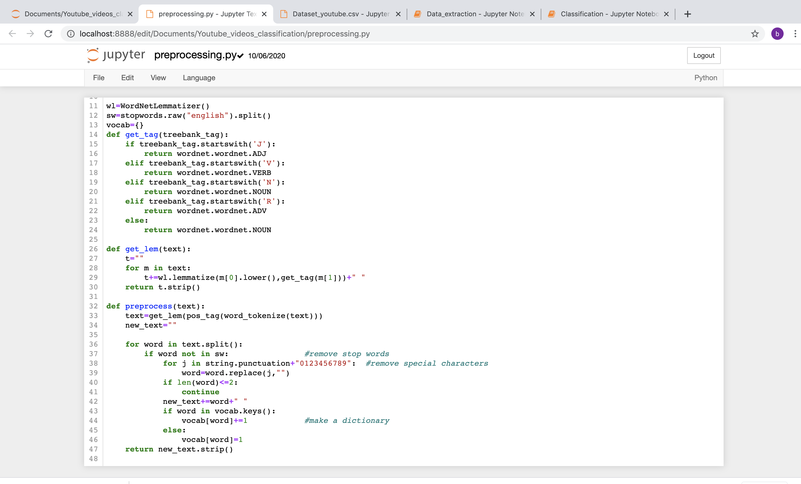

Slide 14
Modelling and Training
The dataset is split into Train and Test sets with a split ratio of 8:2
Features for Title and Description are computed independently and then concatenated to construct a final feature matrix.
The preprocessing python file is imported and after splitting the dataset train dataset is preprocessed and a vocabulary array is made of around 5000 words.
The most repeated words are stored in a features array.

Slide 15
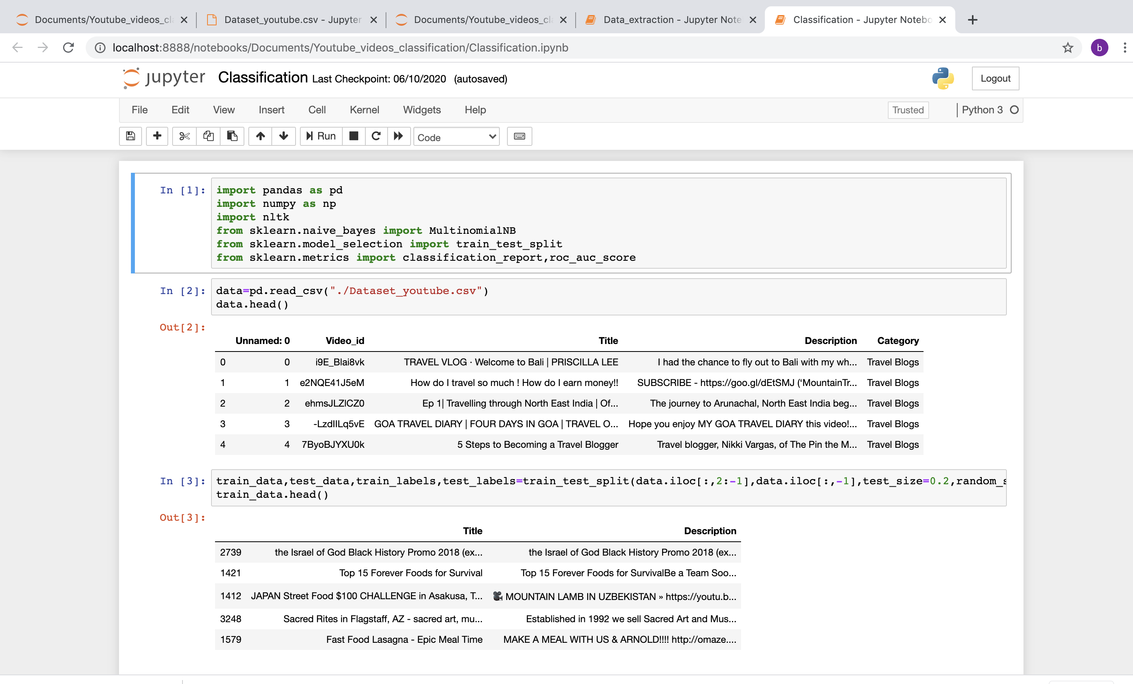
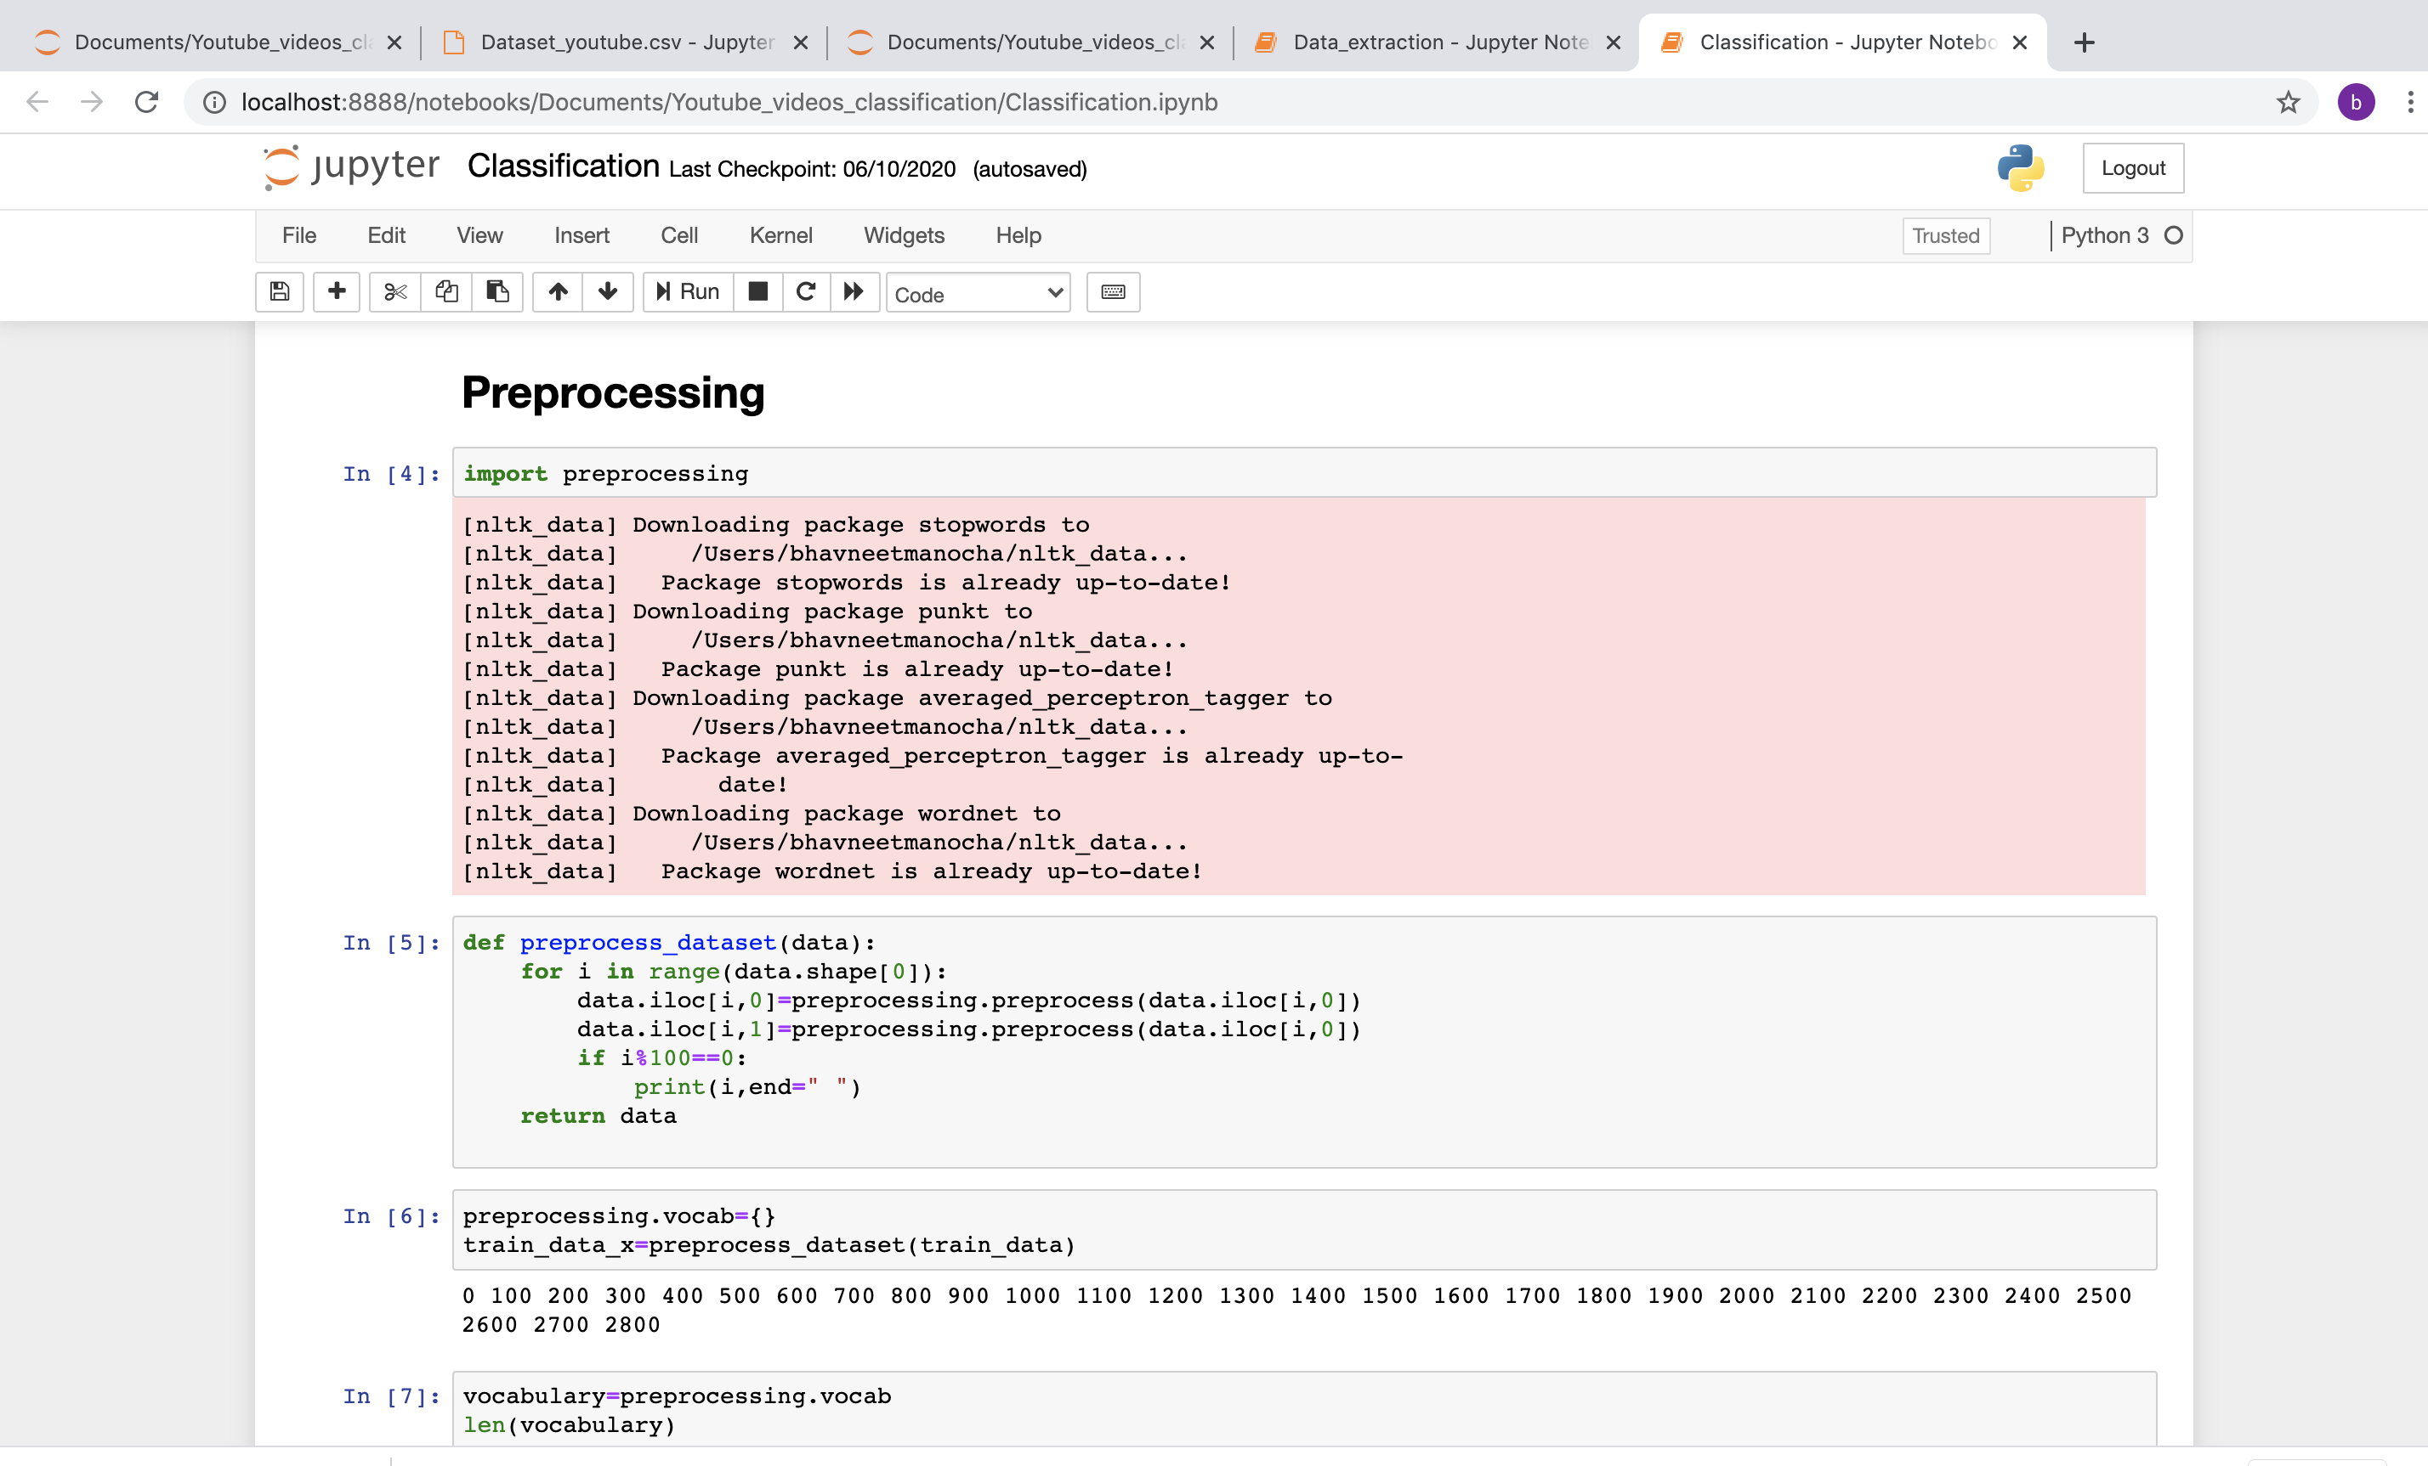

Slide 16
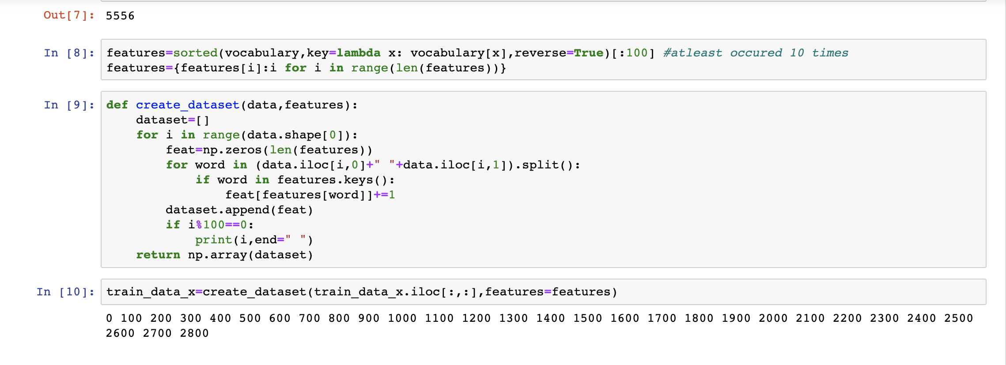

Slide 17
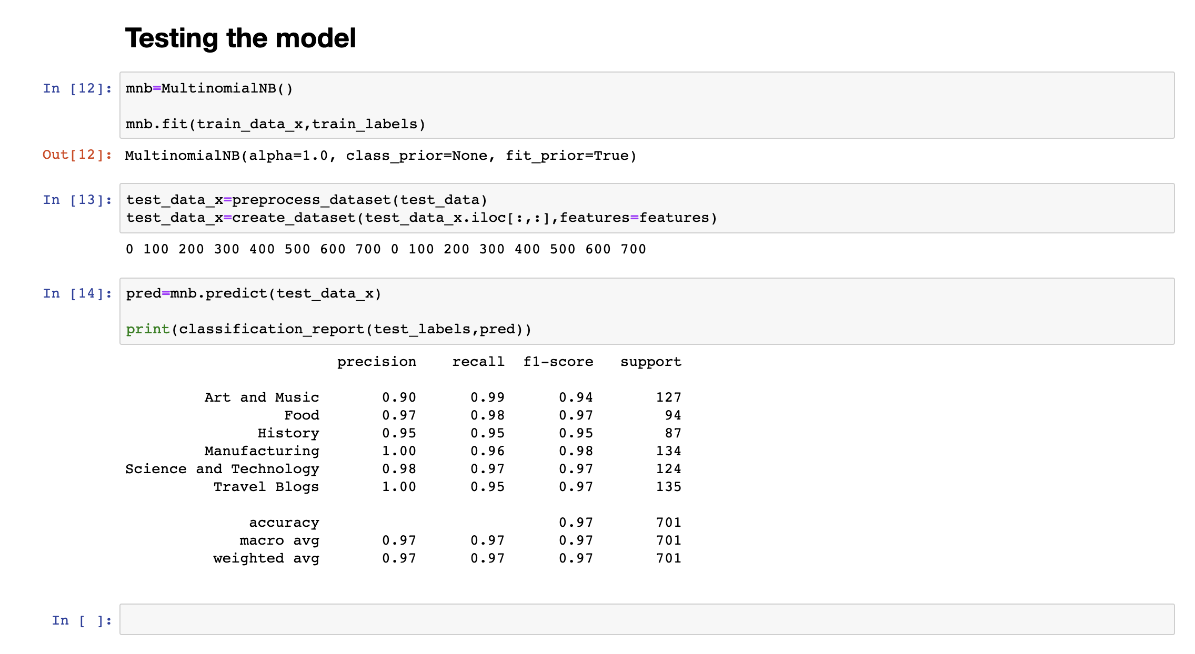
Testing the model
Once the model is trained we can use the same trained model to predict using the testing data i.e. the unseen data. We test the model using evaluation metrics like precision, recall and accuracy.

Slide 18
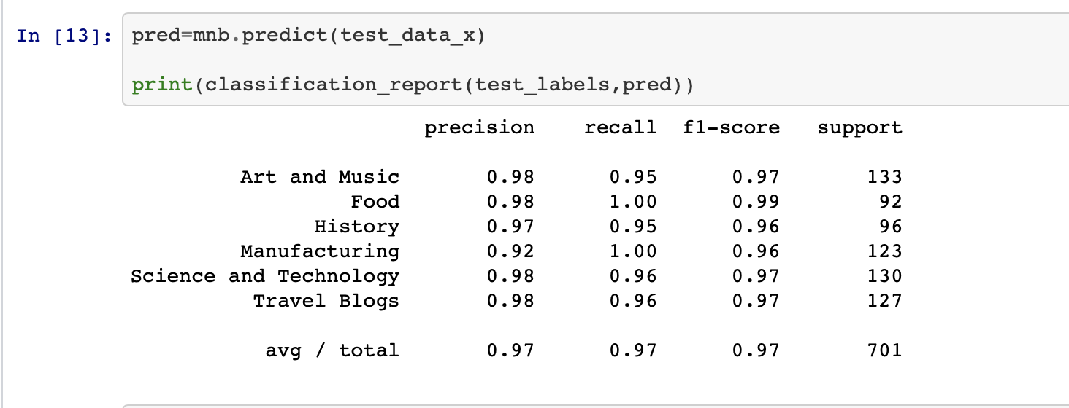
Results

Slide 19
THANK YOU

